Slide 1
ANALYSIS OF Employee​ ​Satisfaction
ADVAIT KULKARNI SUHIT DATTA
VARAD TUPE

Slide 2
The following are the features in the dataset Human Resource Analytics dataset :
Satisfaction Level
Last evaluation
Number of projects
Average monthly hours
Time spent at the company
Whether they have had a work accident
Whether they have had a promotion in the last 5 years
Departments (column sales)
Salary
Whether the employee has left

Slide 3
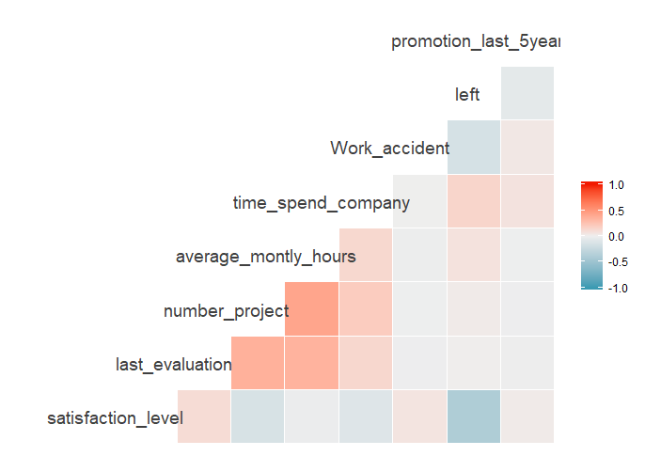
Correlation Plot

Slide 4
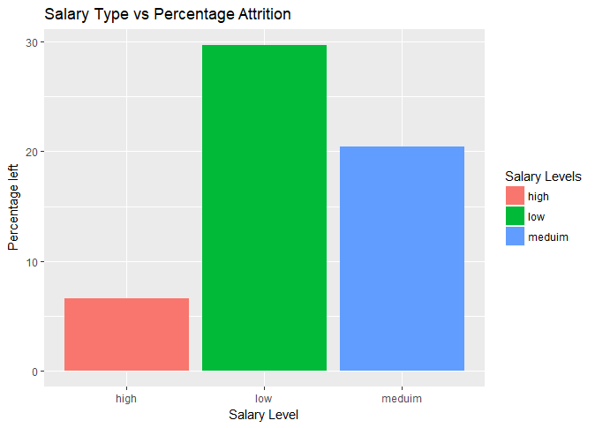
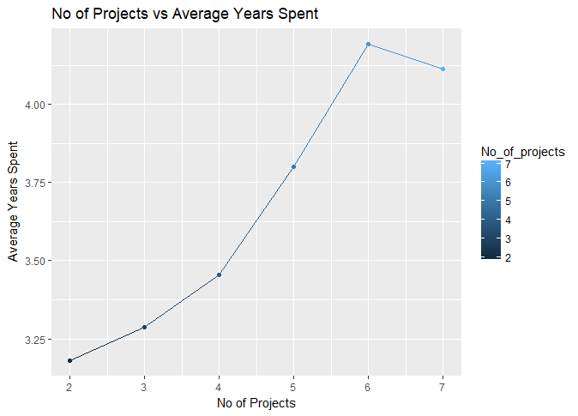
Relationship between No of Projects and the Average Years spent in the Company
Distribution of the Salary Category vs Attrition Percent

Slide 5
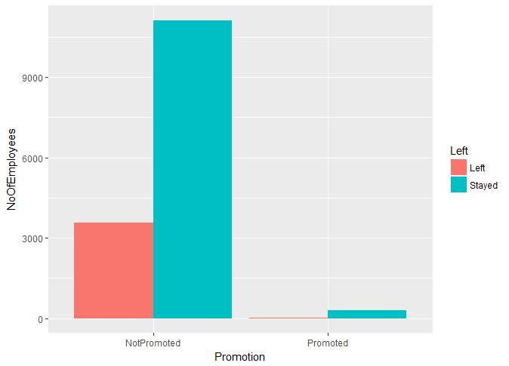
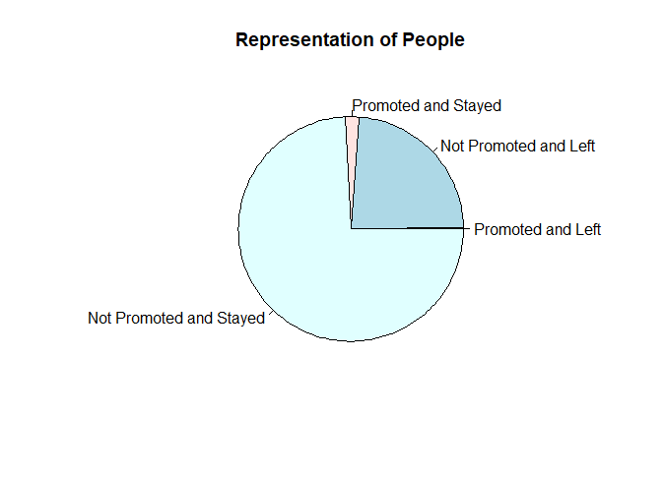
By Promotion in the last 5 years
Almost ¼ th of the people left !

Slide 6
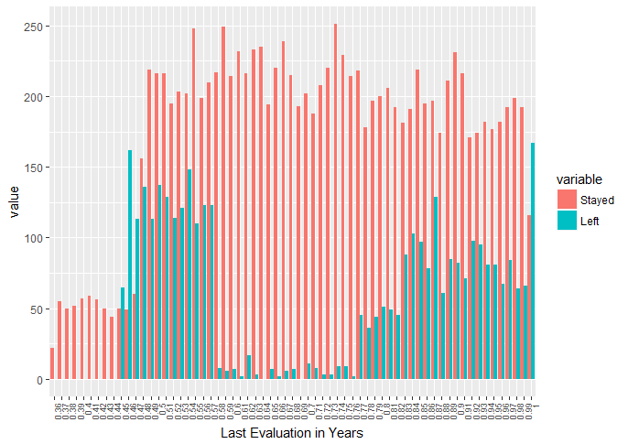
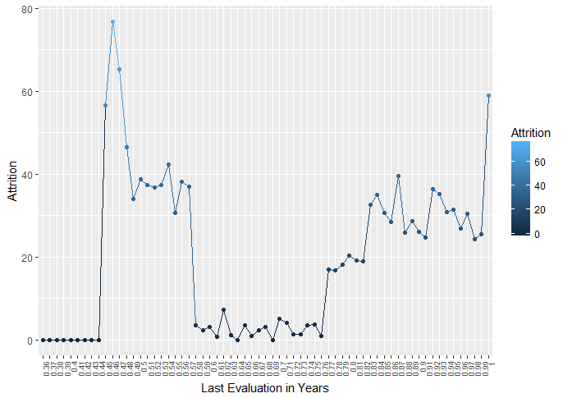
By Last Evaluation

Slide 7
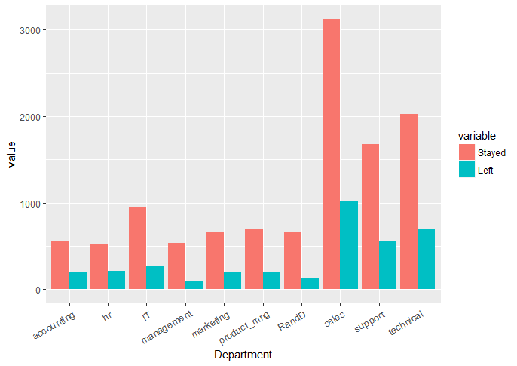
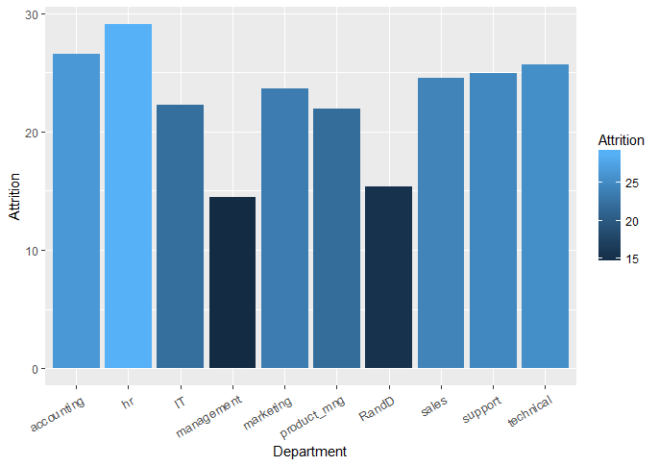
By Department

Slide 8
By Satisfaction Level
Satisfaction Level | Qualitative Equivalent
Greater than 0.8 | Very High
Between 0.6 and 0.8 | High
Between 0.4 and 0.6 | Medium
Between 0.2 and 0.4 | Low
Less than 0.2 | Very Low

Slide 9
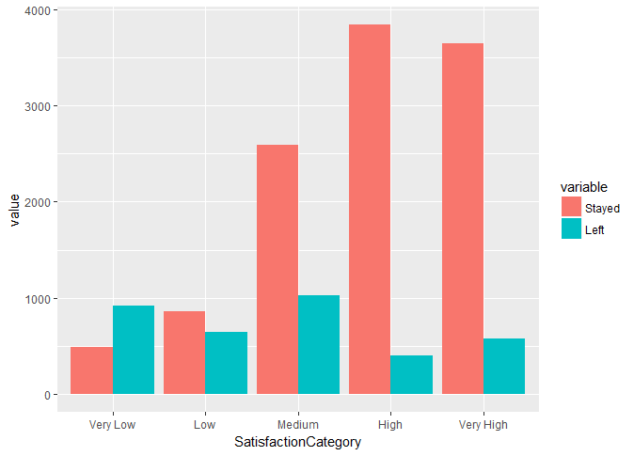
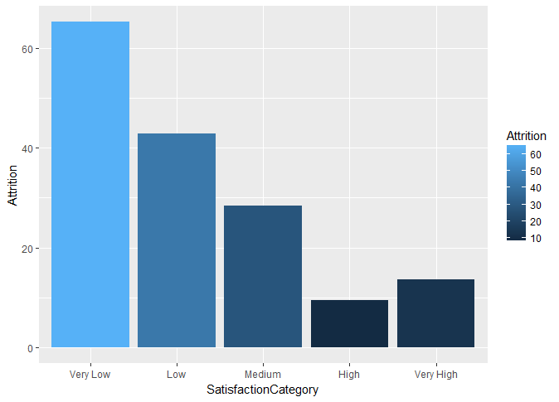

Slide 10
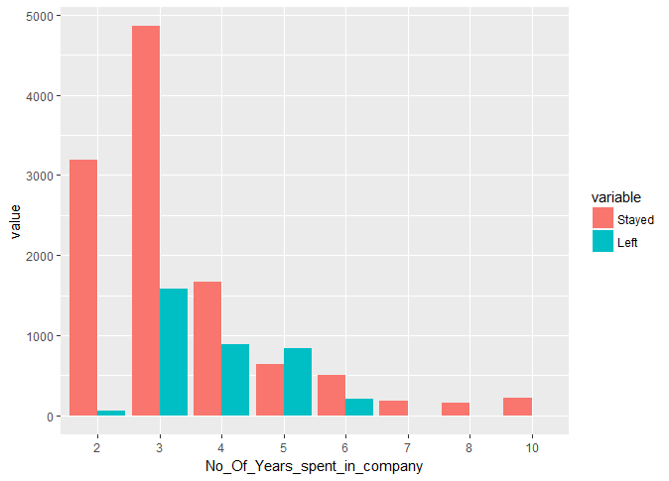
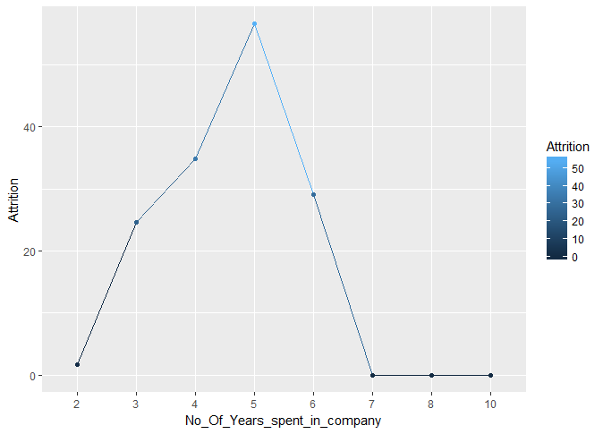
By Number of Years spent in the Company

Slide 11
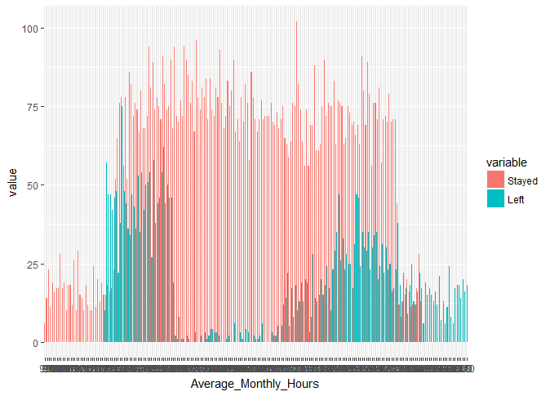
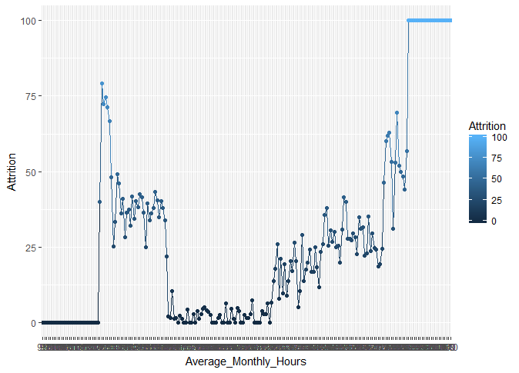
By Average monthly hours spent at Workplace

Slide 12
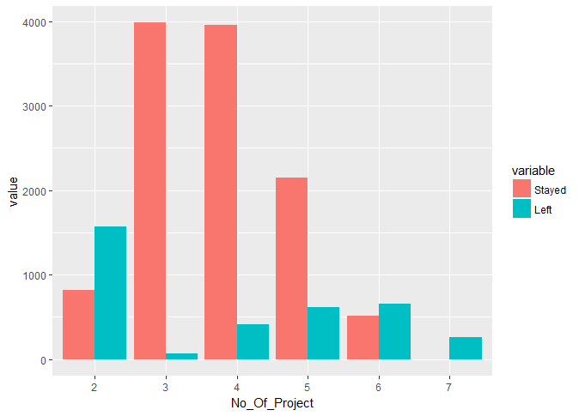
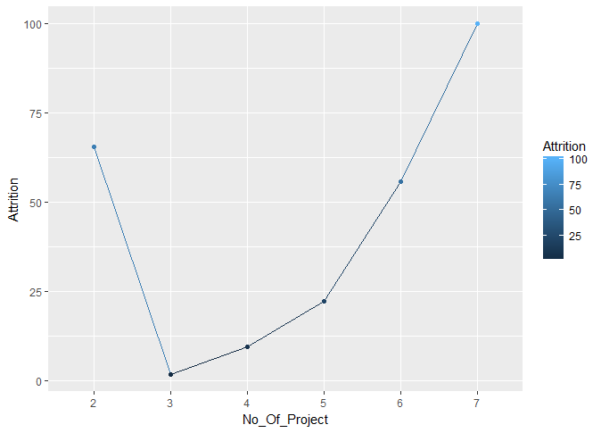
By Number of Projects

